Slide 1

HUMAN ASSISTANCE ROBOT (SIMULATION MODULE)
BACHELOR OF TECHNOLOGY
IN
ELECTRONICS & COMMUNICATION ENGINEERING
Department of Electronics and Communication Engineering
VIGNAN’S INSTITUTE OF INFORMATION TECHNOLOGY (A)
(Affiliated to JNTUK, Approved by AICTE & Accredited by NBA , NAAC with ‘A’ Grade)
(2017-2021)
Project Guide:
1.Dr. S.V. JAGADEESH CHANDRA
PROFESSOR
2.Mr. G.THIAGARAJAN
ASSOCIATE PROFESSOR
ELECTRONICS AND
COMMUNICATION ENGINEERING
BATCH NO. 05
G CHANDRA VAMSI KRISHNA (17L31A0482)
P DIMPLE PRIYA(17L31A04N9)
S VIDYA VARENYA (17L31A0444)
K PRASUNA (17L31A0412)
A NAVYA BHARATHI(17L31A0419)

Slide 2
PROBLEM STATEMENT
Even though technology is developed a lot, we are still using humans to accomplish some basic tasks like sending circulars to each class and also surveying all the classrooms is not an easy task for a single person. So we came up with a solution to send a Human Assistance Robot to complete our tasks.

Slide 3
INTRODUCTION
“Technology makes life easier”
Here comes another technology to assist humans. Yes, It is a human assistance robot. We aim to make a robot that performs the following tasks.
It takes its instruction from administrator through GUI to deliver circulars from class to class and also receives the acknowledgement for the same.
It also takes survey by uploading the photograph to cloud when required.

Slide 4
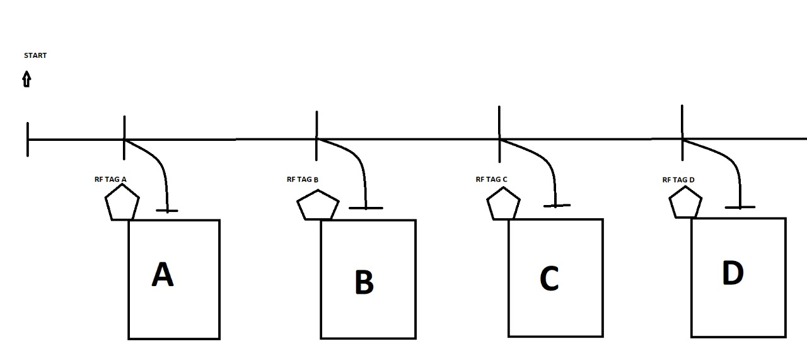
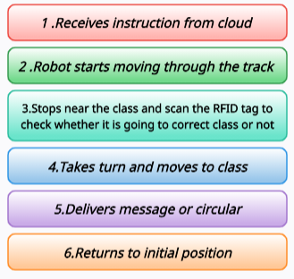
WORK FLOW

Slide 5
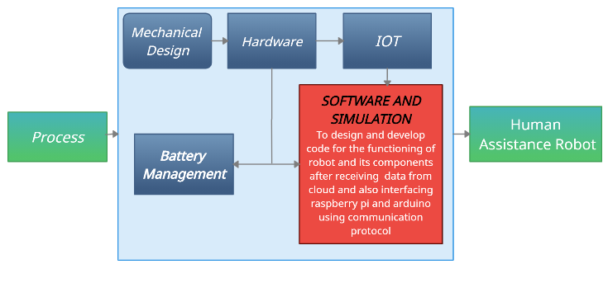
PROJECT FLOW

Slide 6
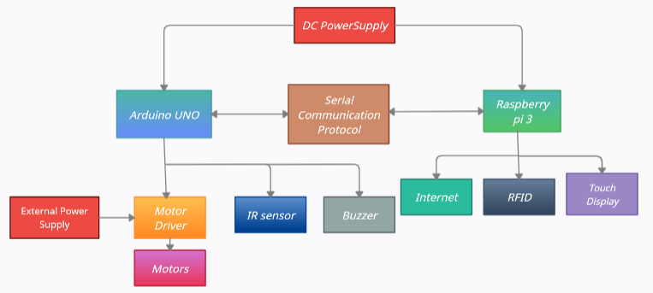
BLOCK DIAGRAM

Slide 7



TOOLS USED
Raspberry pi Operating System
VNC Viewer
Putty
Proteus
Arduino

Slide 8

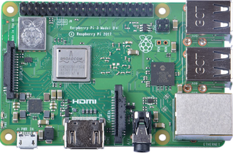
RASPBERRY PI
Raspberry Pi is a credit card sized single board computer which can do everything a normal PC can do. Raspberry Pi 3. It is a low cost CPU which can be used as a general purpose PC for web surfing, video streaming etc.

Slide 9
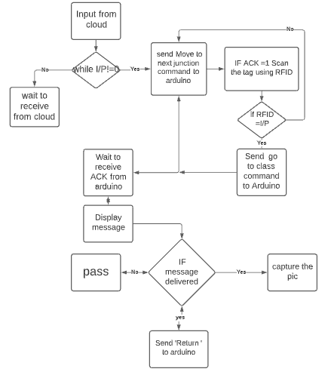
IMPLEMENTATION STEPS
IN RASPBERRY PI

Slide 10
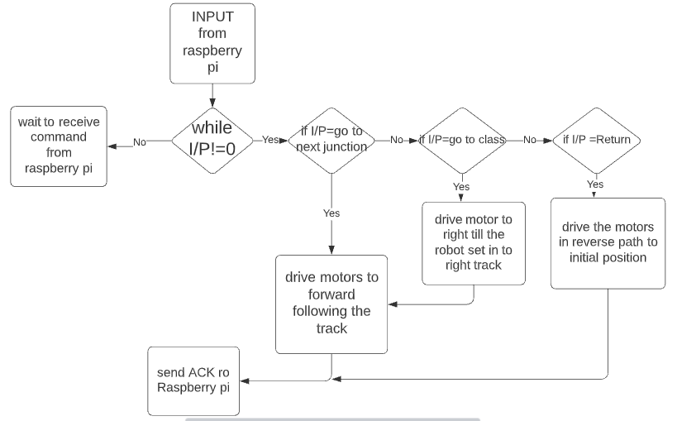
IN ARDUINO

Slide 11
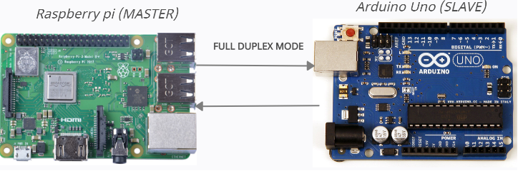
Operates in Master-Slave Mode
Raspberry pi will acts as MASTER as it sends commands to Arduino to function accordingly and Arduino will be the SLAVE.
Both will communicate in Full Duplex Mode

Slide 12
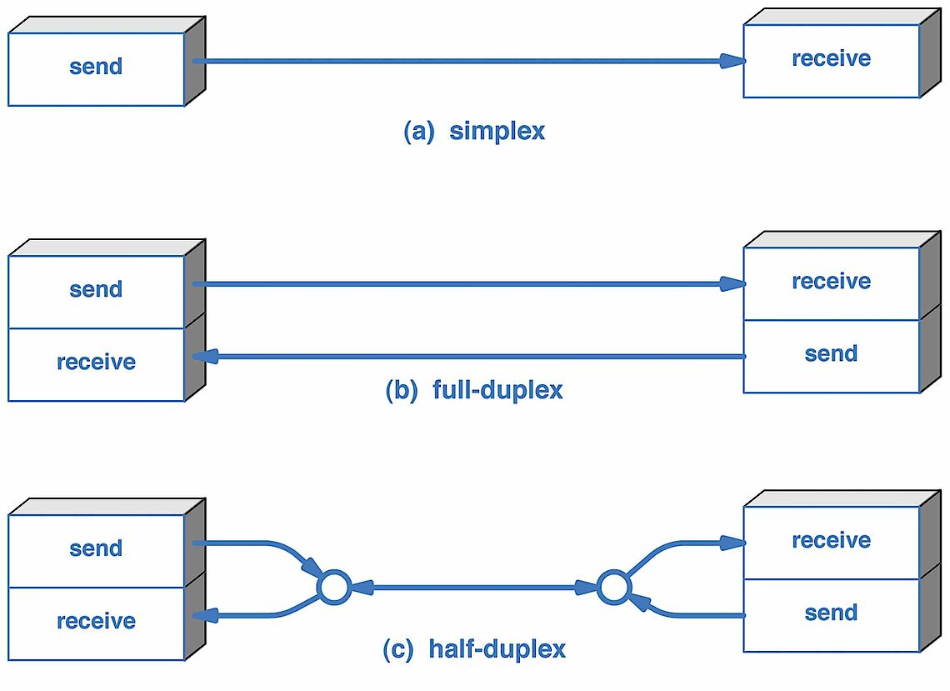
TRANSMISSION MODES
Transmission mode refers to the mechanism of transferring of data between two devices connected over a network. It is also called Communication Mode.

Slide 13
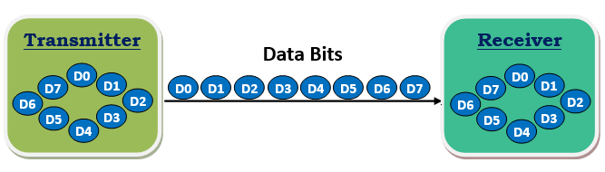
SERIAL COMMUNICATION
In serial communication, the data bits are transmitted one at a time in a sequential manner over the data bus or communication channel.
This protocol is cheaper to implement as it need only single wire to communicate with all peripherals.

Slide 14
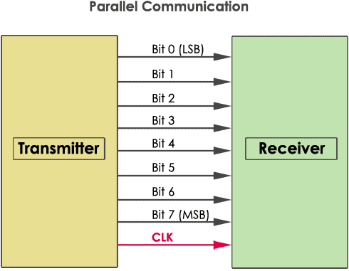
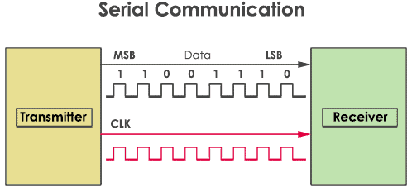
WHY SERIAL COMMUNICATION
The cost of the entire embedded system becomes cheap and transmits the information over a long distance.
Serial communication require only one wire where as Parallel communication need ‘n’ numbers of wires hance cost increases.

Slide 15
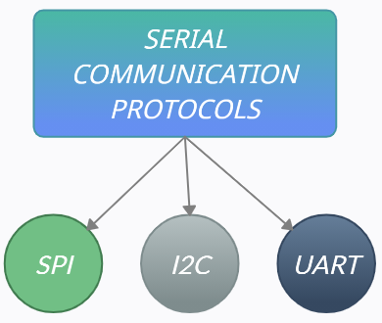
PROTOCOLS SUITABLE FOR SERIAL COMMUNICATION
1.Serial Peripheral Interface
2.Inter-Integrated Circuit
3.Universal Asynchronous
Receiver Transmitter

Slide 16
Action plan :
Till now we have gathered the components, required information, designed flow charts for step by step implementation of code. Now we have started working on proteus and also on protocols for interfacing Raspberry pi and Arduino.
Our robot comes in to operation in 3 weeks of time

Slide 17
THANK YOU

